Slide 1
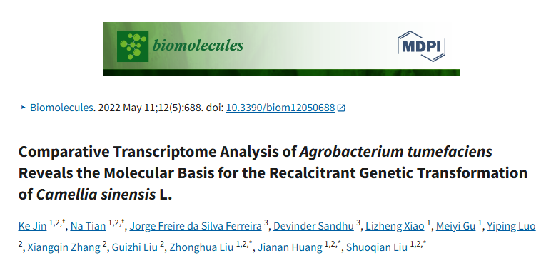





BCB 546 Final Project Presentation
By
Faizo Kasule, Sherpa Lakpa, Kofi Antwi Appiagyei, Lucky Kofi Gbeda & Rishaniya Parthasarathy

Slide 2
Presentation Outline
Background
Introduction to Agrobacterium tumefaciens
Biological question under investigation
Aim and specific objectives
Workflow methodology (Group vs Paper)
RNA seq pipeline
Overview of the group documents
Results comparison
Conclusion

Slide 3
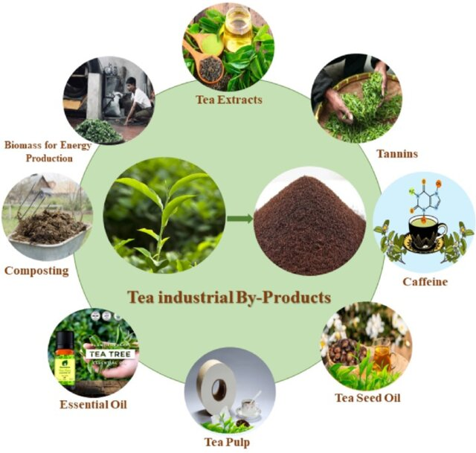
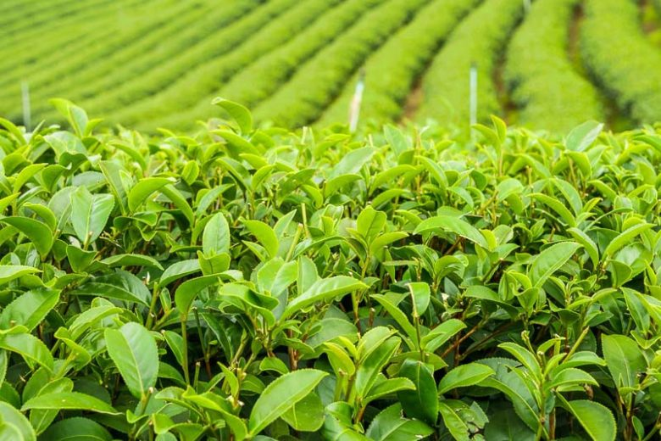
Background
Tea (Camellia sinensis L.)
Grown for beverages and food products
Generates a combined revenue of US$294.45 billion in 2025
Difficulty in improving plant varieties through traditional methods
Molecular breeding techniques like Agrobacterium-mediated transformation (AMT) are used
Mandal et al., 2024
Notes:
Tea is a valuable crop grown worldwide for its use in beverages and food products. However, improving tea plant varieties through traditional breeding methods is difficult due to the plant's long life cycle and challenges in pollination. To speed up improvement, scientists turn to molecular breeding techniques like Agrobacterium-mediated transformation (AMT)—a common method used to insert new genes into plants.
Agrobacterium is a soil bacterium that naturally transfers part of its DNA into plants, making it a useful tool for genetic engineering. It works by detecting plant signals at wound sites, attaching to plant cells, and using a system of proteins to transfer a special DNA segment (called T-DNA) into the plant's genome. This process has been very successful in many crops like tomato and soybean. However, in tea plants, this method does not work well, especially when using leaf tissues, which are important for keeping the plant’s original traits.
To better understand the reasons behind this difficulty, this study investigates the interactions between Agrobacterium and tea leaves at the cellular and molecular levels. By analyzing changes in bacterial growth, attachment, and gene expression during infection, the research aims to uncover the biological barriers that make tea plants resistant to transformation, and to offer insights for improving genetic engineering techniques in tea breeding.

Slide 4
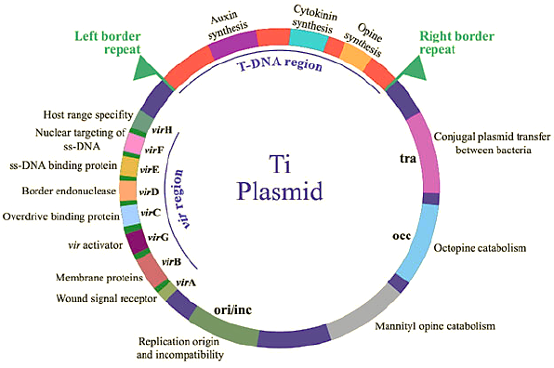
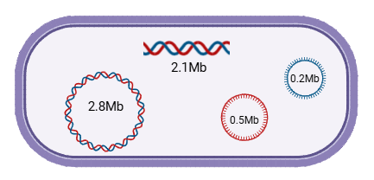
Introduction to Agrobacterium tumefaciens
Agrobacterium tumefaciens
A soil bacterium that naturally transfers part of its DNA into plants
Detects and attaches to plant wound sites, transfers T-DNA into the plant genome
Challenging to implement in tea leaves
Gelvin (2003); Weisberg et al. (2020; 2022; 2023)

Slide 5
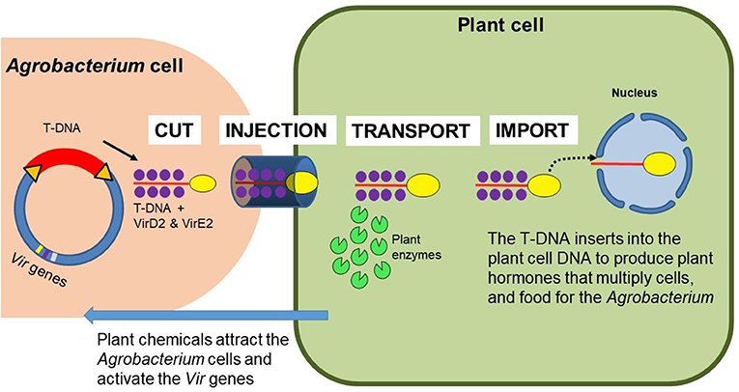
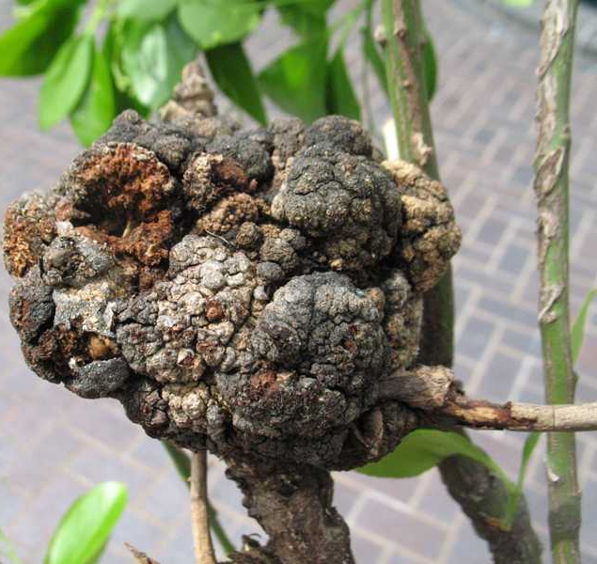
Agrobacterium transfer DNA from its Ti-plasmid into the plant genome
Auxin
& cytokinin genes
Ti
plasmid
Overexpression of phytohormonal genes stimulates cell division
(Crown gall disease).
Modified from frontiersin.org

Slide 6
Problem Statement
Tea is recalcitrant to Agrobacterium-mediated transformation due to;
Inhibitory metabolites like catechins (Flavonoids) and unknown metabolites, which disrupt bacterial attachment and morphology.
Additionally, tea competes for ions like iron and potassium, impairing Agrobacterium quorum sensing and infection efficiency. These factors, along with strong plant defense responses, reduce transformation success.
Studies on tea plant genetics and breeding are hindered due to its recalcitrance to Agrobacterium-mediated genetic transformation.
Fizikova, et al., 2024

Slide 7
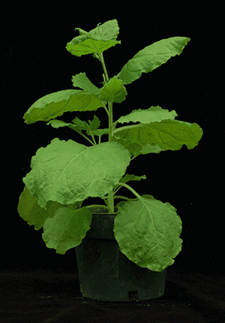
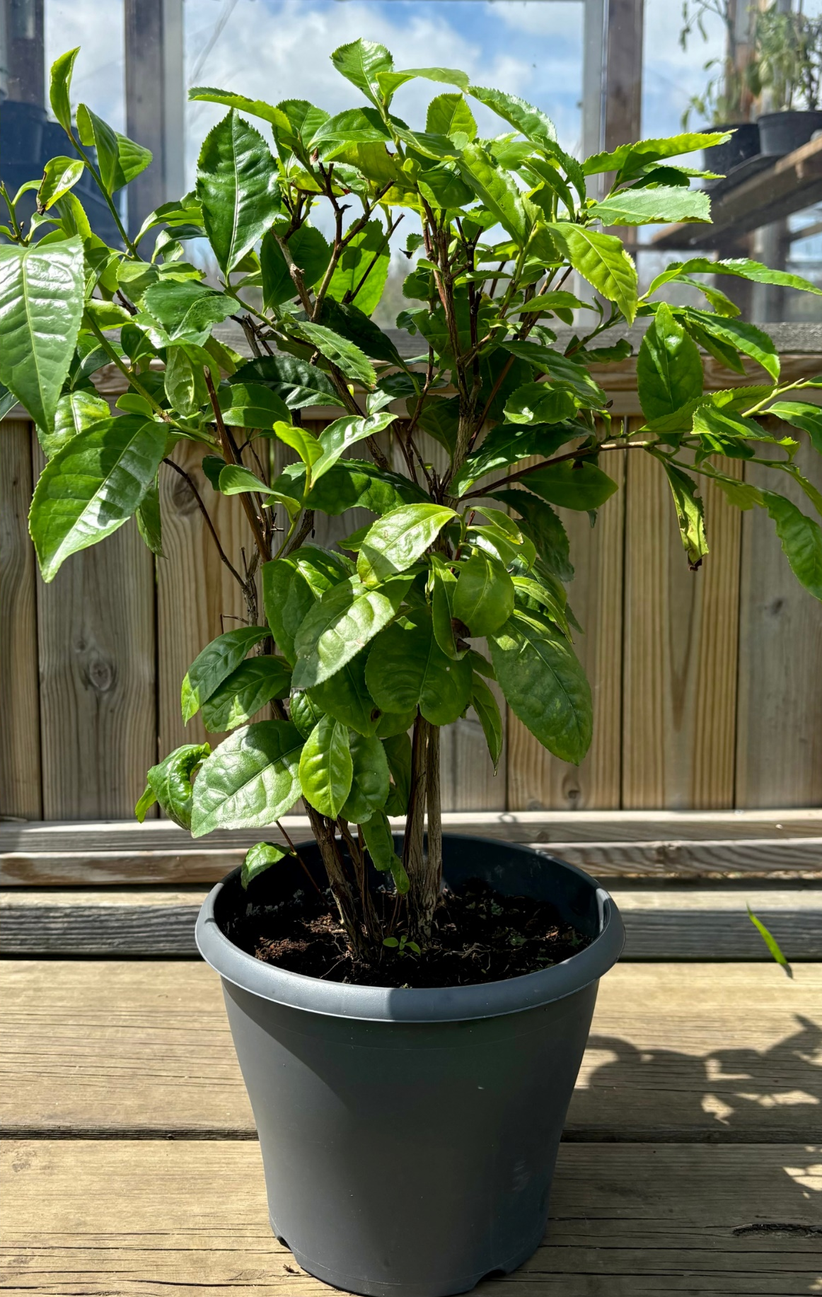
Biological question
This study aimed to uncover the molecular and physiological factors contributing to the recalcitrance of Camellia sinensis (tea) to Agrobacterium-mediated transformation (AMT).
The approach used was to compare Agrobacterium interactions with tea and the highly transformable model plant Nicotiana benthamiana.
Nicotiana benthamiana
Camellia sinensis (tea)
Boyce Thompson institute for plant research

Slide 8
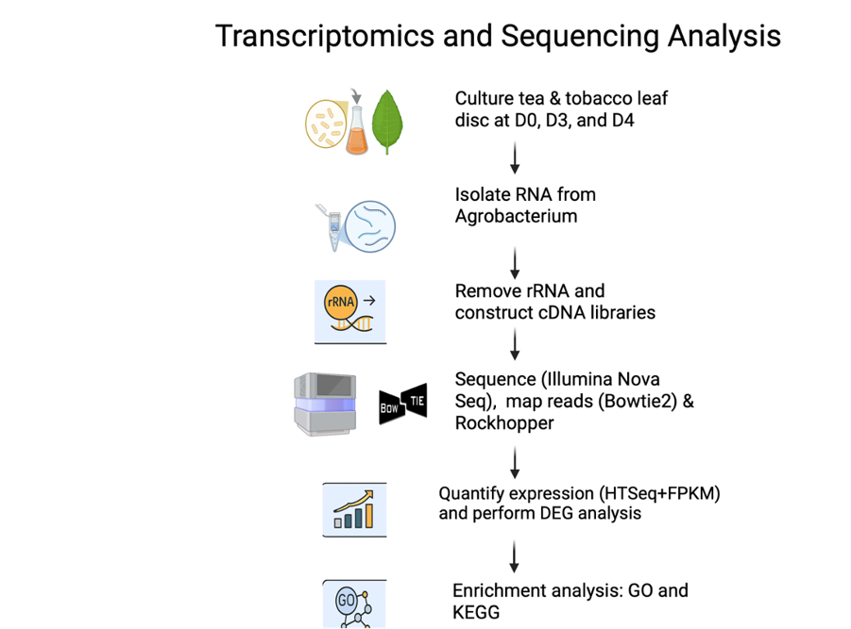
Workflow
Created in BioRender
Notes:
GV3101 agrobacterium bacteria were grown and transformed into disc shaped leaved ad D0 (30 mins of infections), D2(72hours-> bacteria has enough time to deliver its DNA to plant), D3 (96hrs to check whether change persists, enhancer or decline). RNA was isolated from the AG, construct cDNA libraries. Sequence by using Illumina nova seq to create short reads of gene expression. Short reads were mapped with reference genome of Agrobacterium and plasmid pMKV060 using Bowtie2. Rockhooper was used to align reads with speci

Slide 9
Data Management and Sharing Plan
1.Raw sequencing data: Retrieved from NCBI Sequence Read Archive (SRA)
2. Processed data:
Converted FASTQ files
Quality control (QC) reports (FastQC, MultiQC)
Aligned sequence files in BAM format (from STAR or HISAT2)
Gene-level count matrices (from featureCounts or HTSeq)
Normalized expression data (TPM, FPKM, or DESeq2-normalized counts)
Differentially expressed gene (DEG) lists (CSV/TSV)
Heatmaps and visualizations of DEGs, including KEGG pathway genes
3. Metadata:
Sample metadata (sample names, treatment groups, SRA accession numbers)
Bioinformatic workflow scripts
4. Policies for Access and Sharing (Processed data (BAM, counts, normalized data, DEG lists, and figures) will be Deposited in GitHub
5. Reuse, Redistribution, and Derivatives (Clear documentation (README files) will accompany all datasets to ensure transparency and reproducibility)

Slide 10
Workflow (RNA-Seq Analysis Pipeline)
Samples and Reference Genome Download
Tool: NCBI & ENA
Quality Control Check
Tools: FastQC & MultiQC
Trim Low-Quality Reads & Adapters
Tool: Trimmomatic
Quality Control Check
Tools: FastQC & MultiQC
Indexing
Tool: Samtools
Sort by Genomic Coordinate
Tool: Samtools
Convert SAM files to BAM
Tool: Samtools
Read Alignment to Reference Genome
Tool: HISAT2
Sorting by Name
Tool: Samtools
Quantification of Gene Expression
(Count Matrix)
Tool: HTSeq-count
Calculate FPKM
Tool: R
Normalization & PCA
Tool: R
Differential Gene Expression Analysis
Tool: DESeq2 in R
Filter DEGs
Tool: R
Visualization of DEGs
Tool: R

Slide 11
Transcriptomic Analysis of Agrobacterium during Genetic Transformation
Results

Slide 12
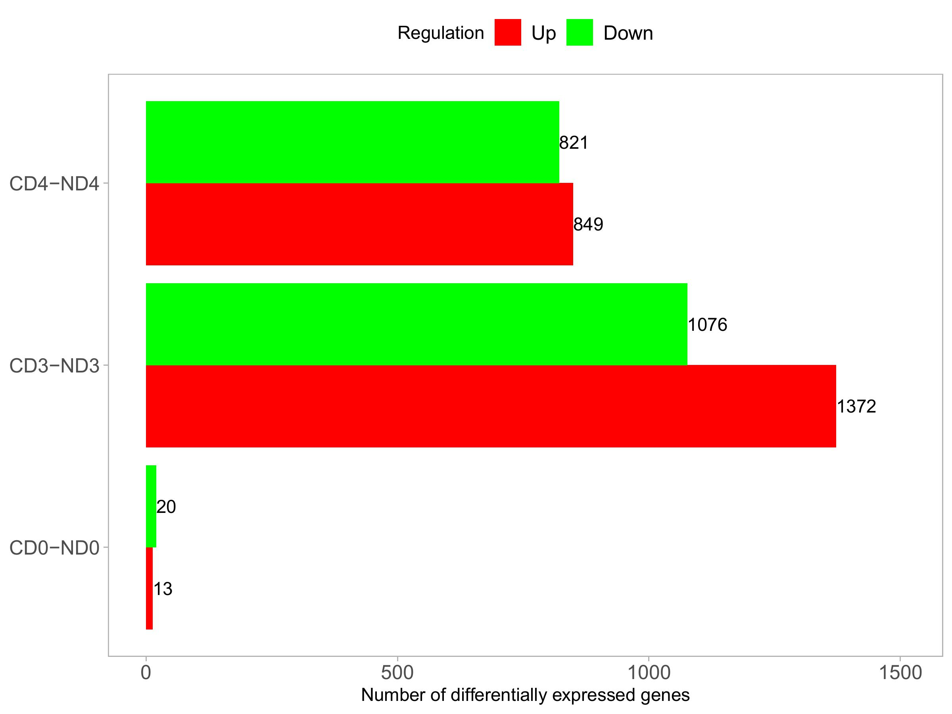
Differentially expressed genes (DEGs)
Results Comparison
Disclaimer; A total of 762, 1923, and 1656 differentially expressed genes (DEGs) were found in the tea groups compared to the tobacco groups at the same time-points on day 0, day 3, and day 4, respectively.
https://usegalaxy.org/

Slide 13
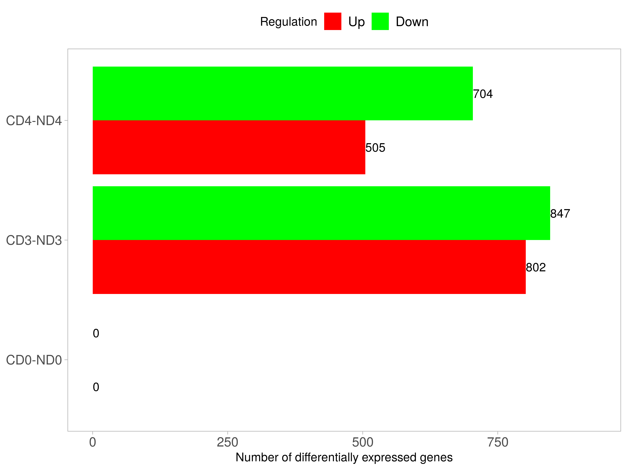
Paper actual DEG results vs what they reported
Disclaimer; A total of 762, 1923, and 1656 differentially expressed genes (DEGs) were found in the tea groups compared to the tobacco groups at the same time-points on day 0, day 3, and day 4, respectively.

Slide 14
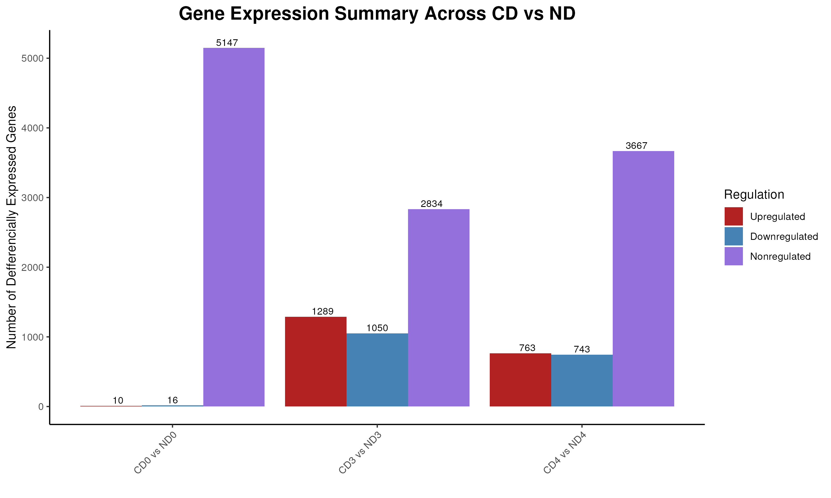
Differentially expressed genes (DEGs)
Results
Disclaimer; A total of 762, 1923, and 1656 differentially expressed genes (DEGs) were found in the tea groups compared to the tobacco groups at the same time-points on day 0, day 3, and day 4, respectively.
However, the results from our customized pipeline and Galaxy are very close.

Slide 15
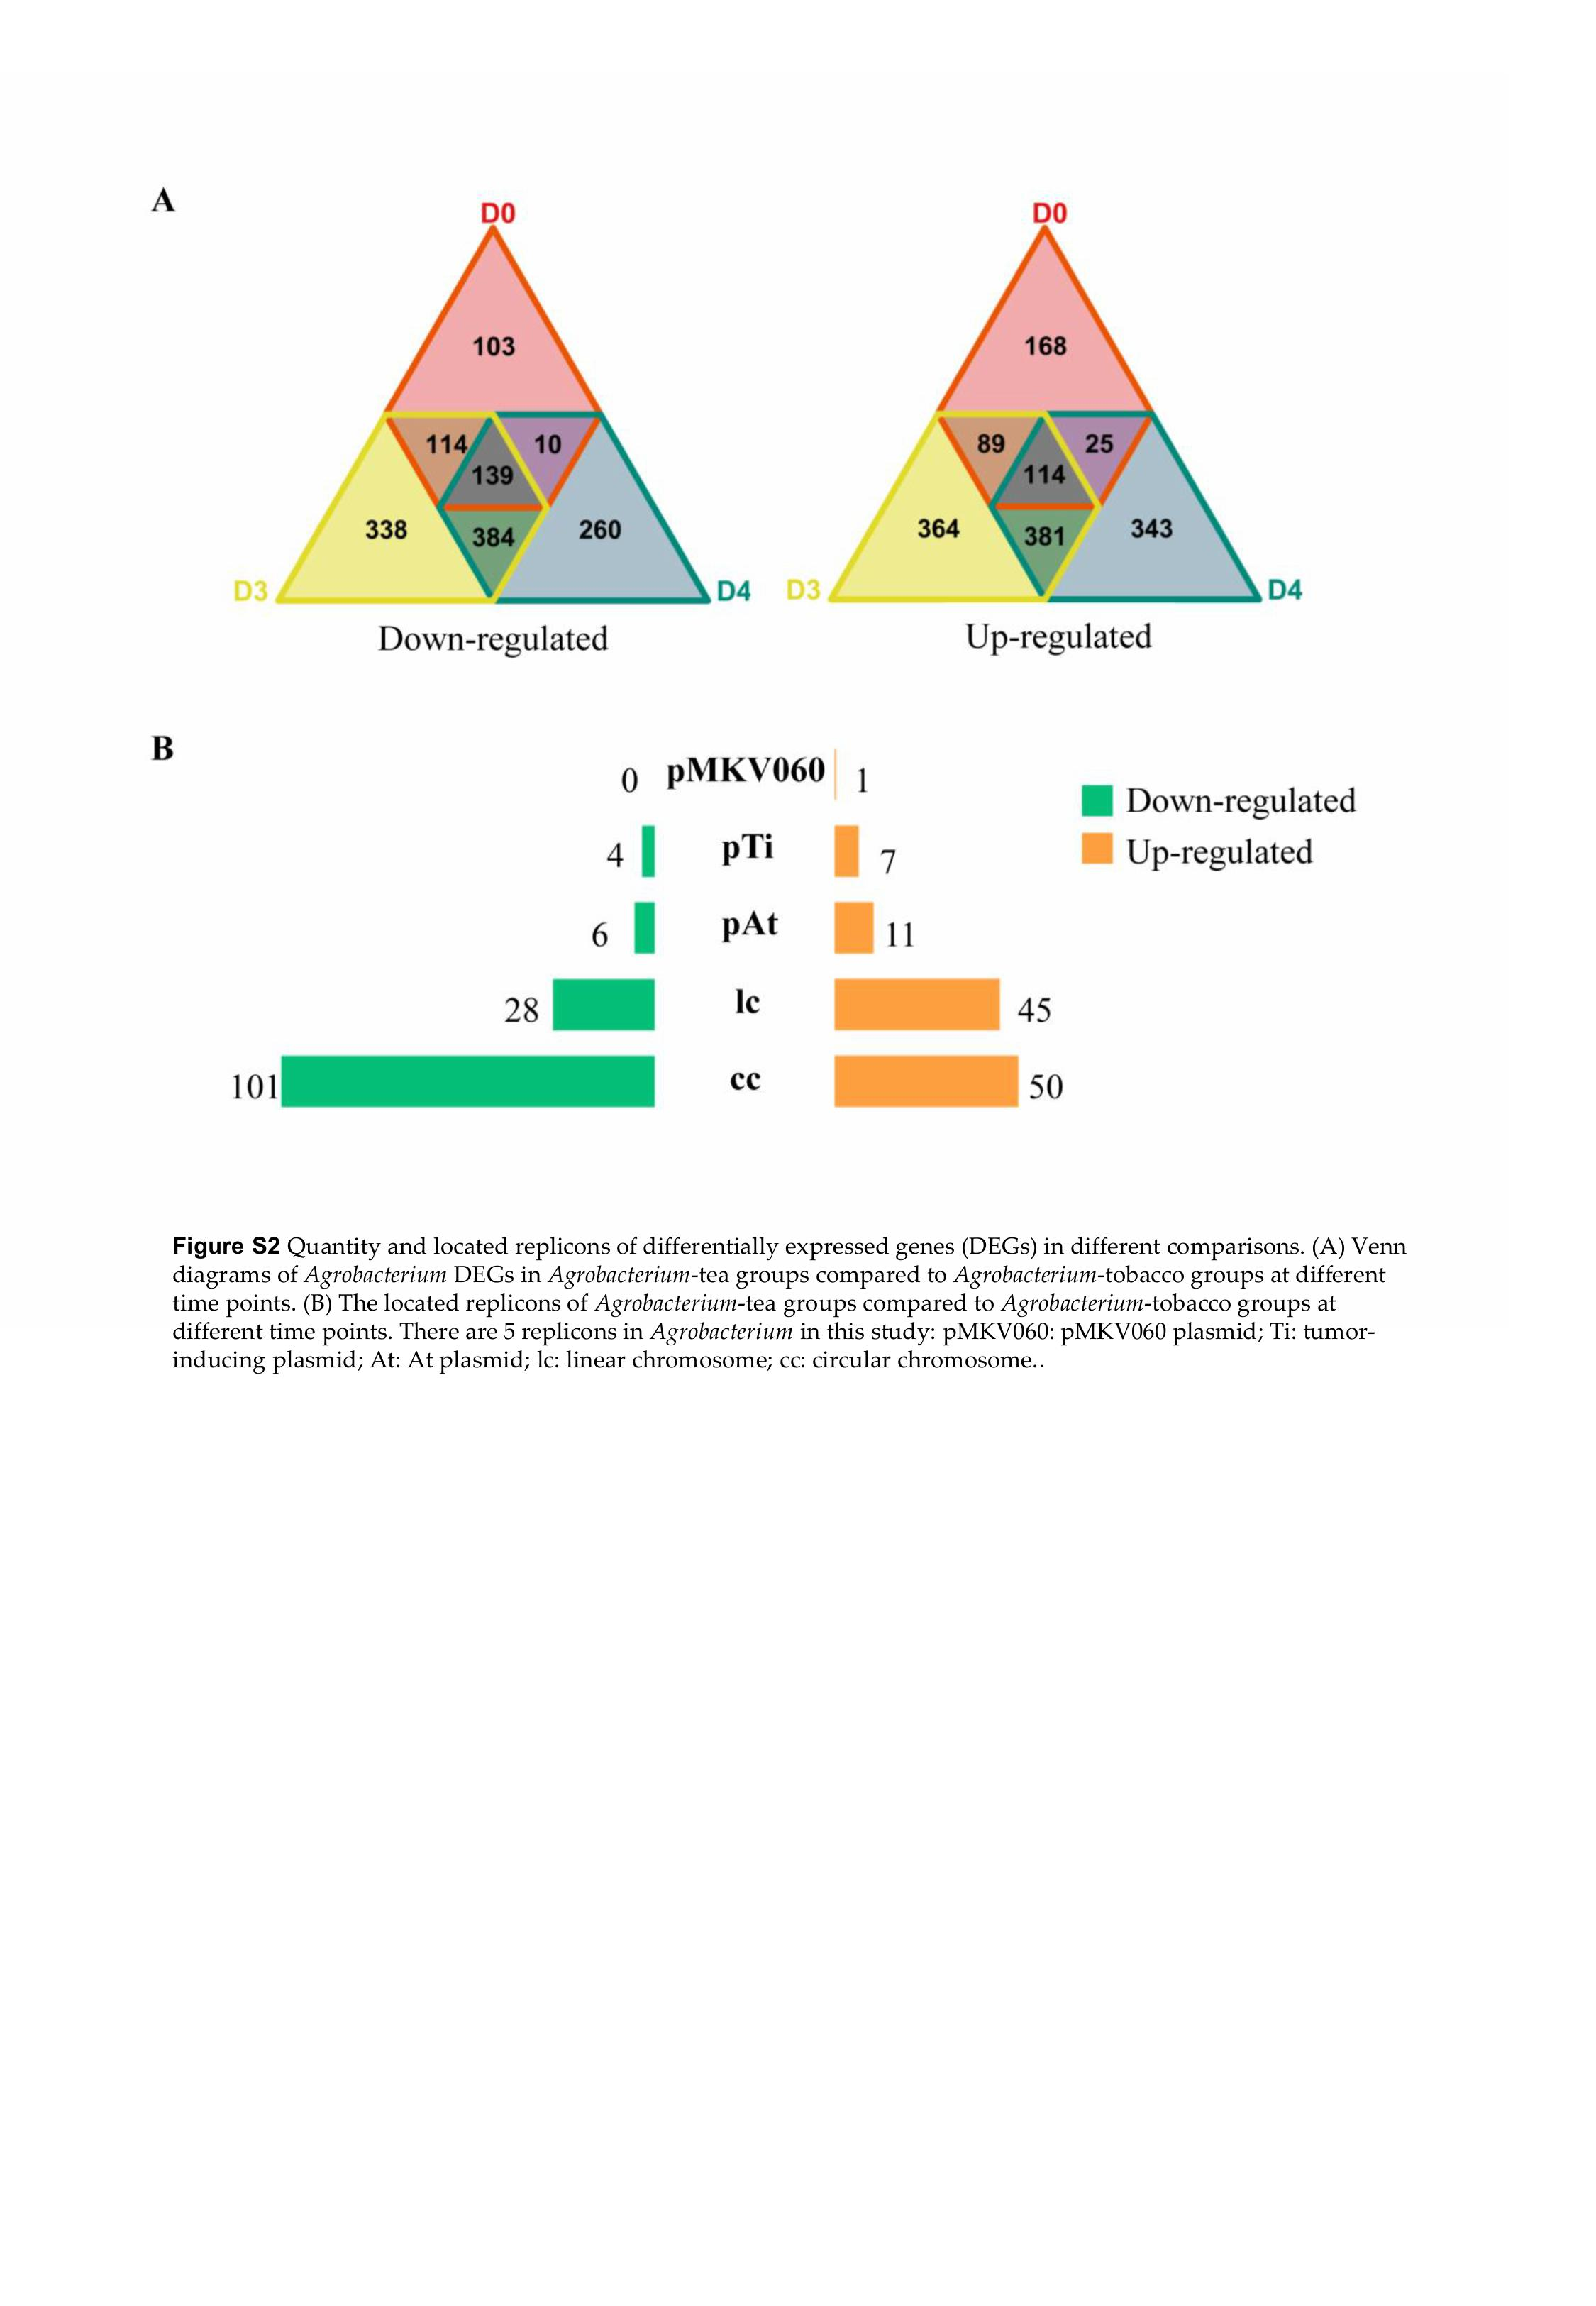
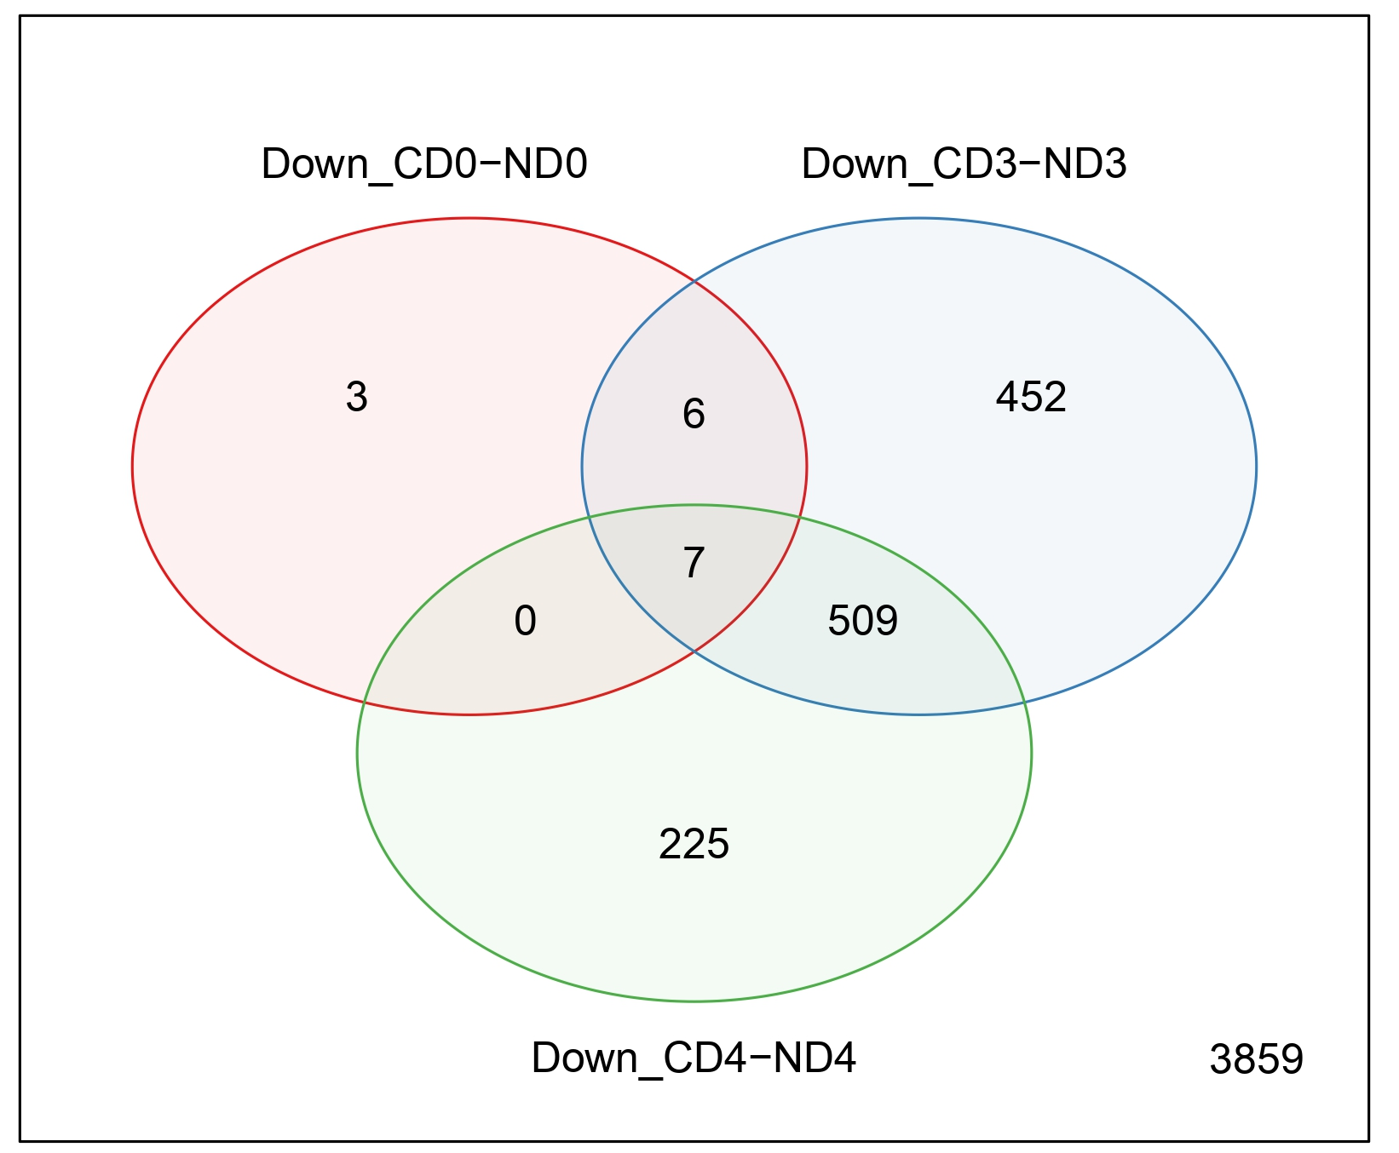
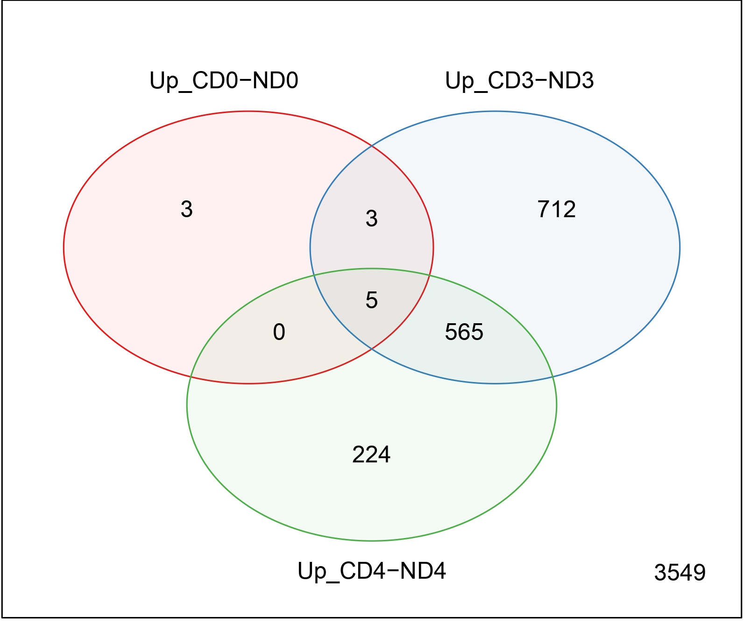
Differentially expressed genes (DEGs)
Results Comparison
Figure S2A
https://usegalaxy.org/

Slide 16
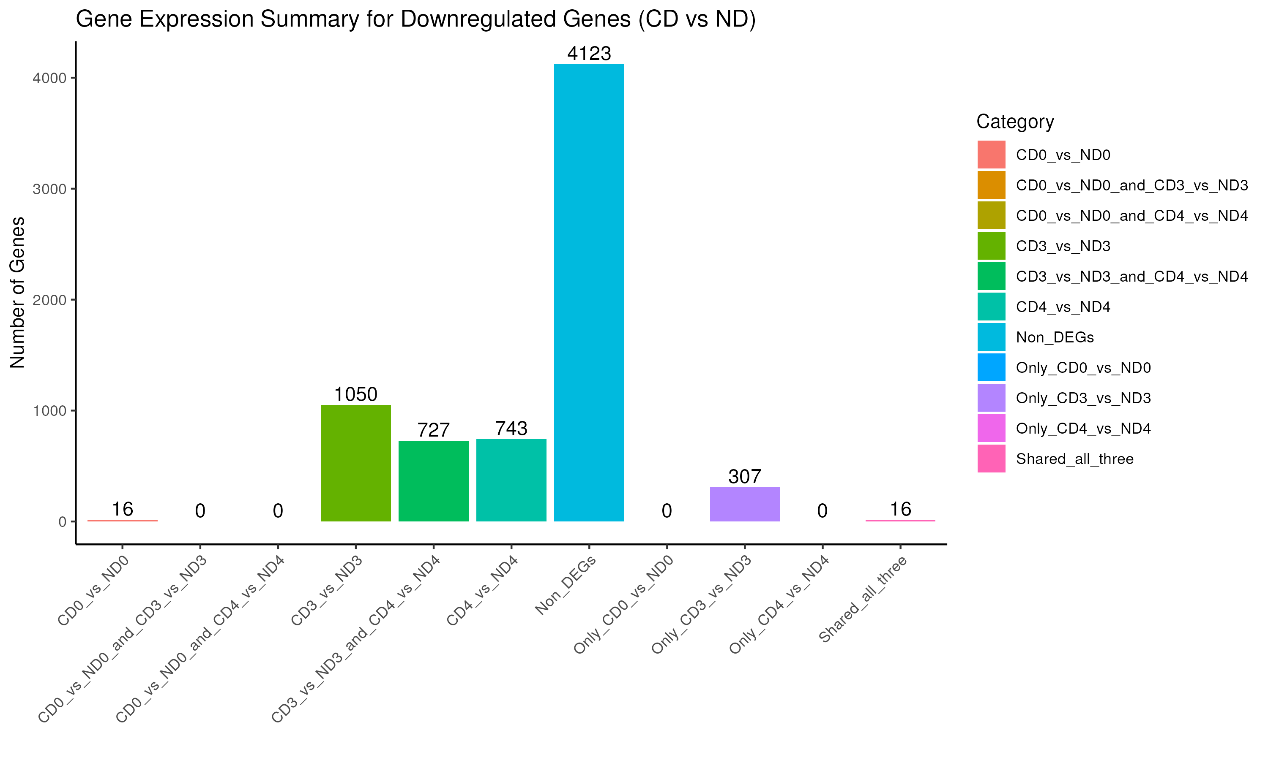
Differentially expressed genes (DEGs)
Results Comparison
Figure S2A

Slide 17
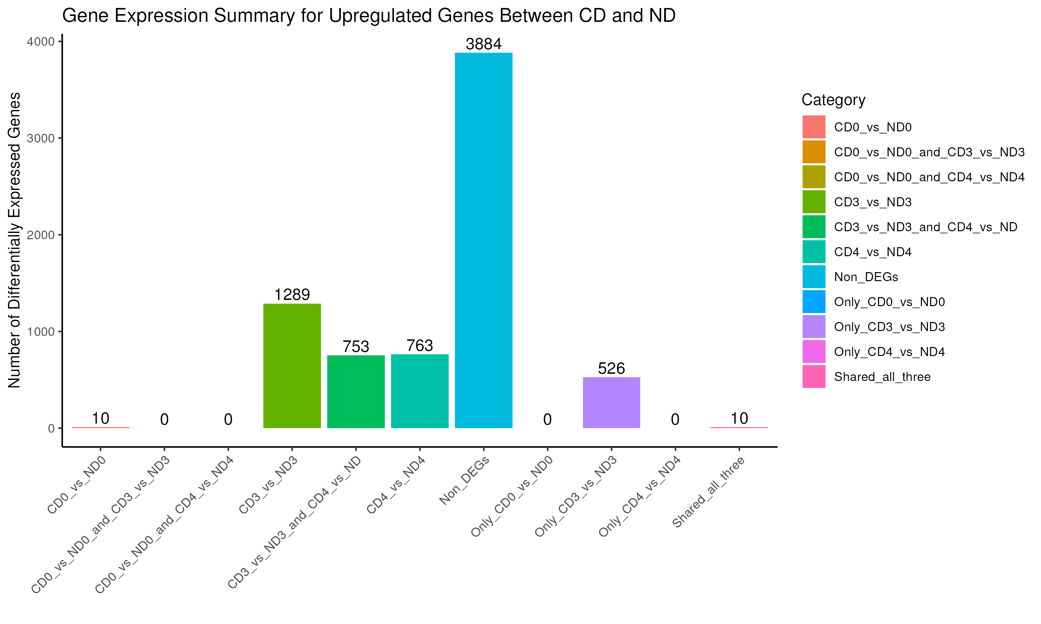
Differentially expressed genes (DEGs)
Results Comparison
Figure S2A

Slide 18
Gene Ontology Enrichment Analysis
Results Comparison

Slide 19
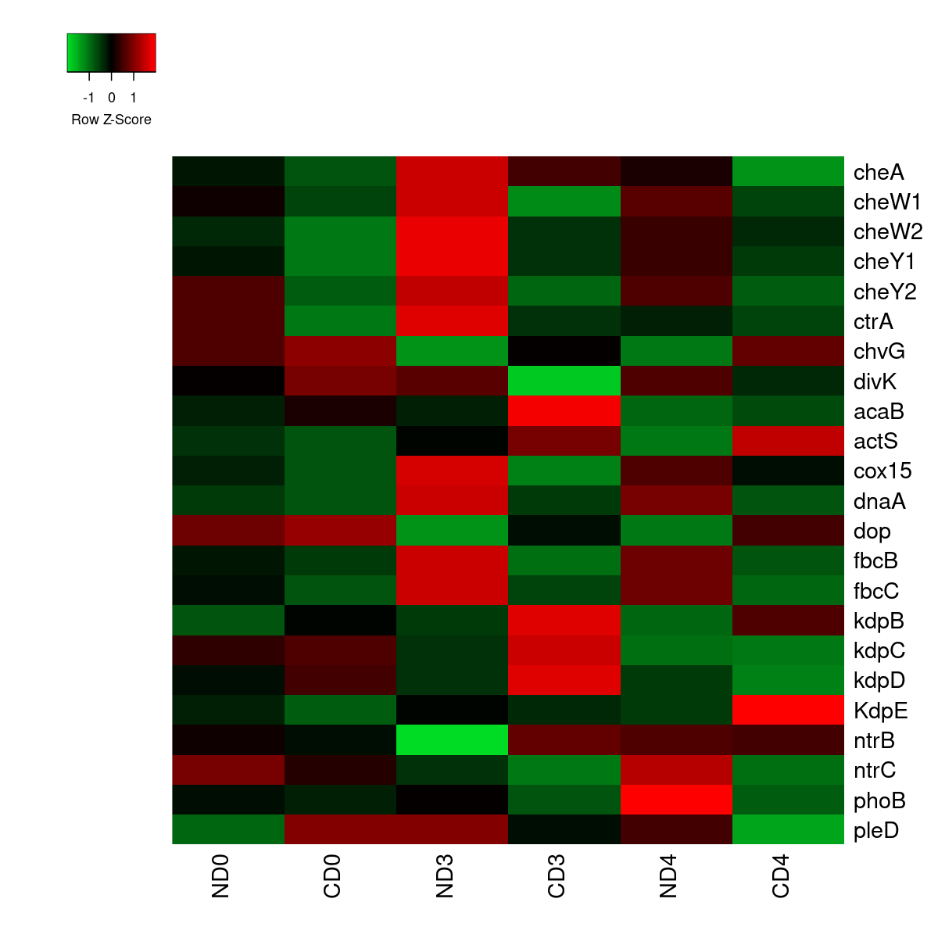
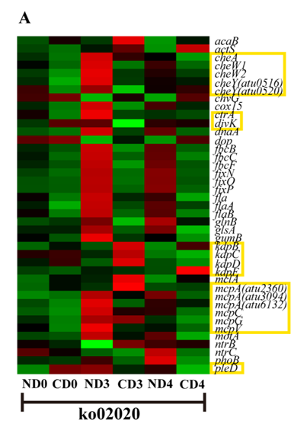
Expression Pattern Analysis of Genes Related to Environmental Information Processing
Results Comparison
The chemotaxis family, cell cycle family, ompR family down regulated in tea.
Tea group samples showed consistent down-regulation of mcp, cheA, cheW1, and cheW2 across all time points, with cheY down-regulated on days 0 and 3. (Figure 3A).

Slide 20
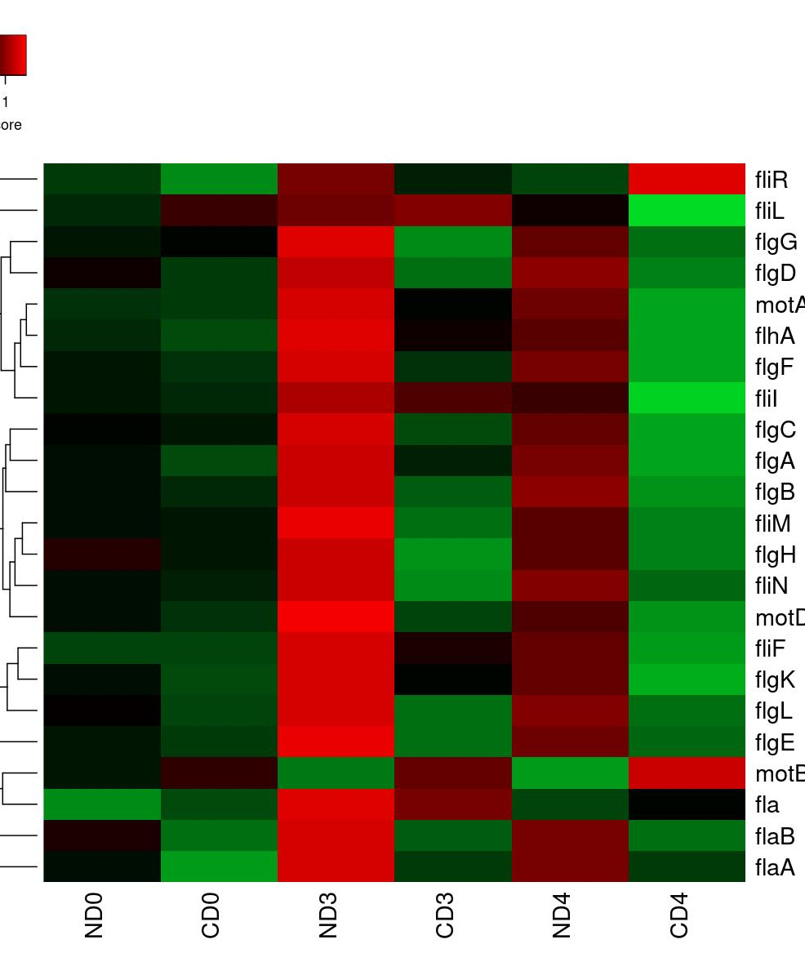
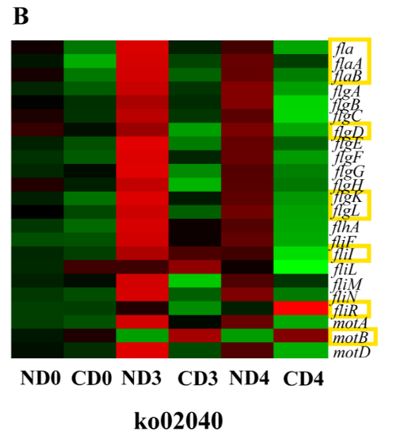
Expression Pattern Analysis of Genes Related to Cellular Processes
In the bacterial chemotaxis pathway most genes were down-regulated in the tea group showed reduced expression.
By day 3, additional genes including fliM and motA were also down-regulated.
On day 4, nearly all pathway genes were suppressed except mclA, motB, and rbsB (Fig 4B)

Slide 21
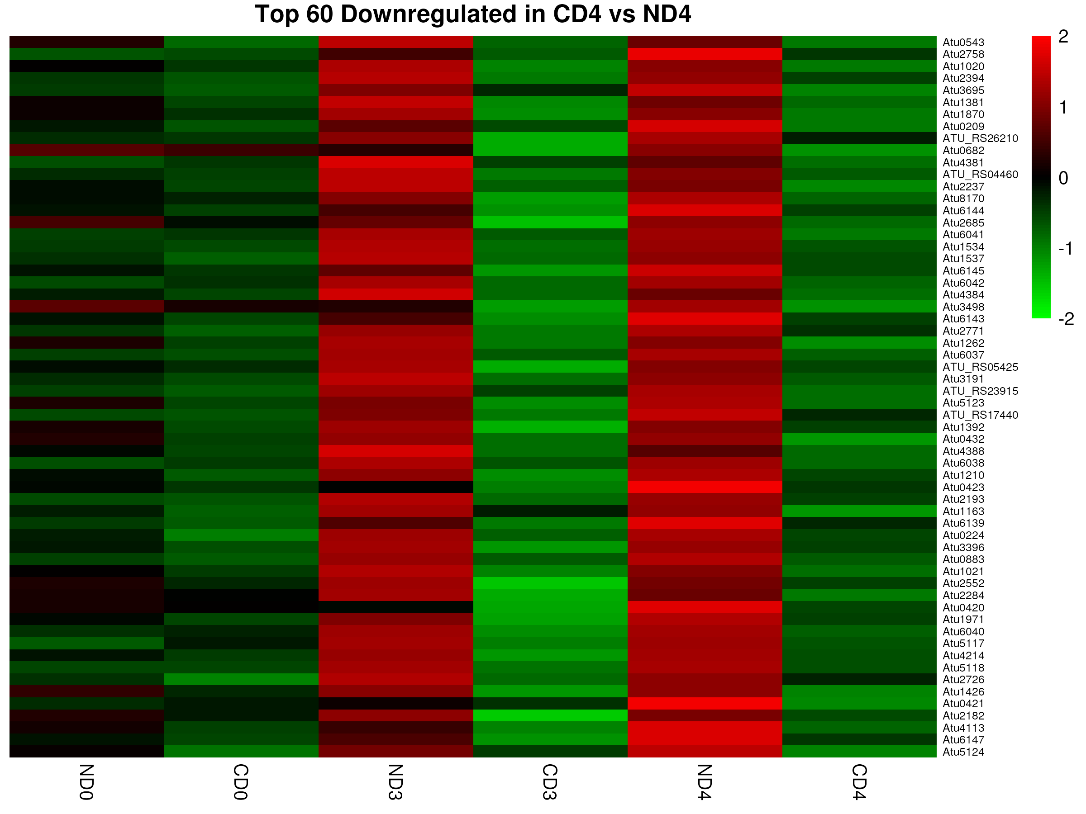
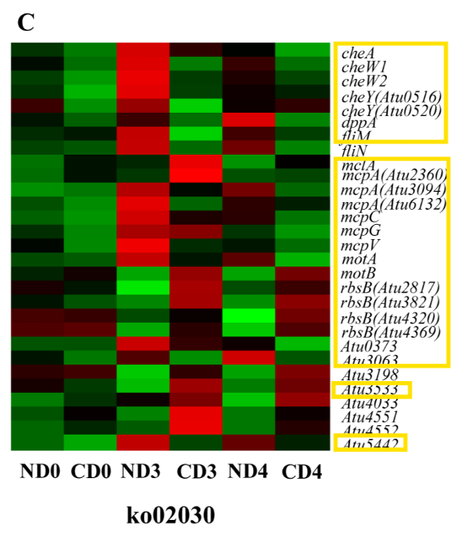
Flagellar gene down-regulation in tea reduces Agrobacterium motility
In the flagellar assembly pathway, most genes essential for bacterial motility (e.g., fla, flg, fli) were down-regulated in tea (Fig 4C).
Implication: Reduced flagellar gene expression weakens Agrobacterium's mobility and ability to reach or attach to tea plant cells, contributing to tea's resistance to infection.

Slide 22
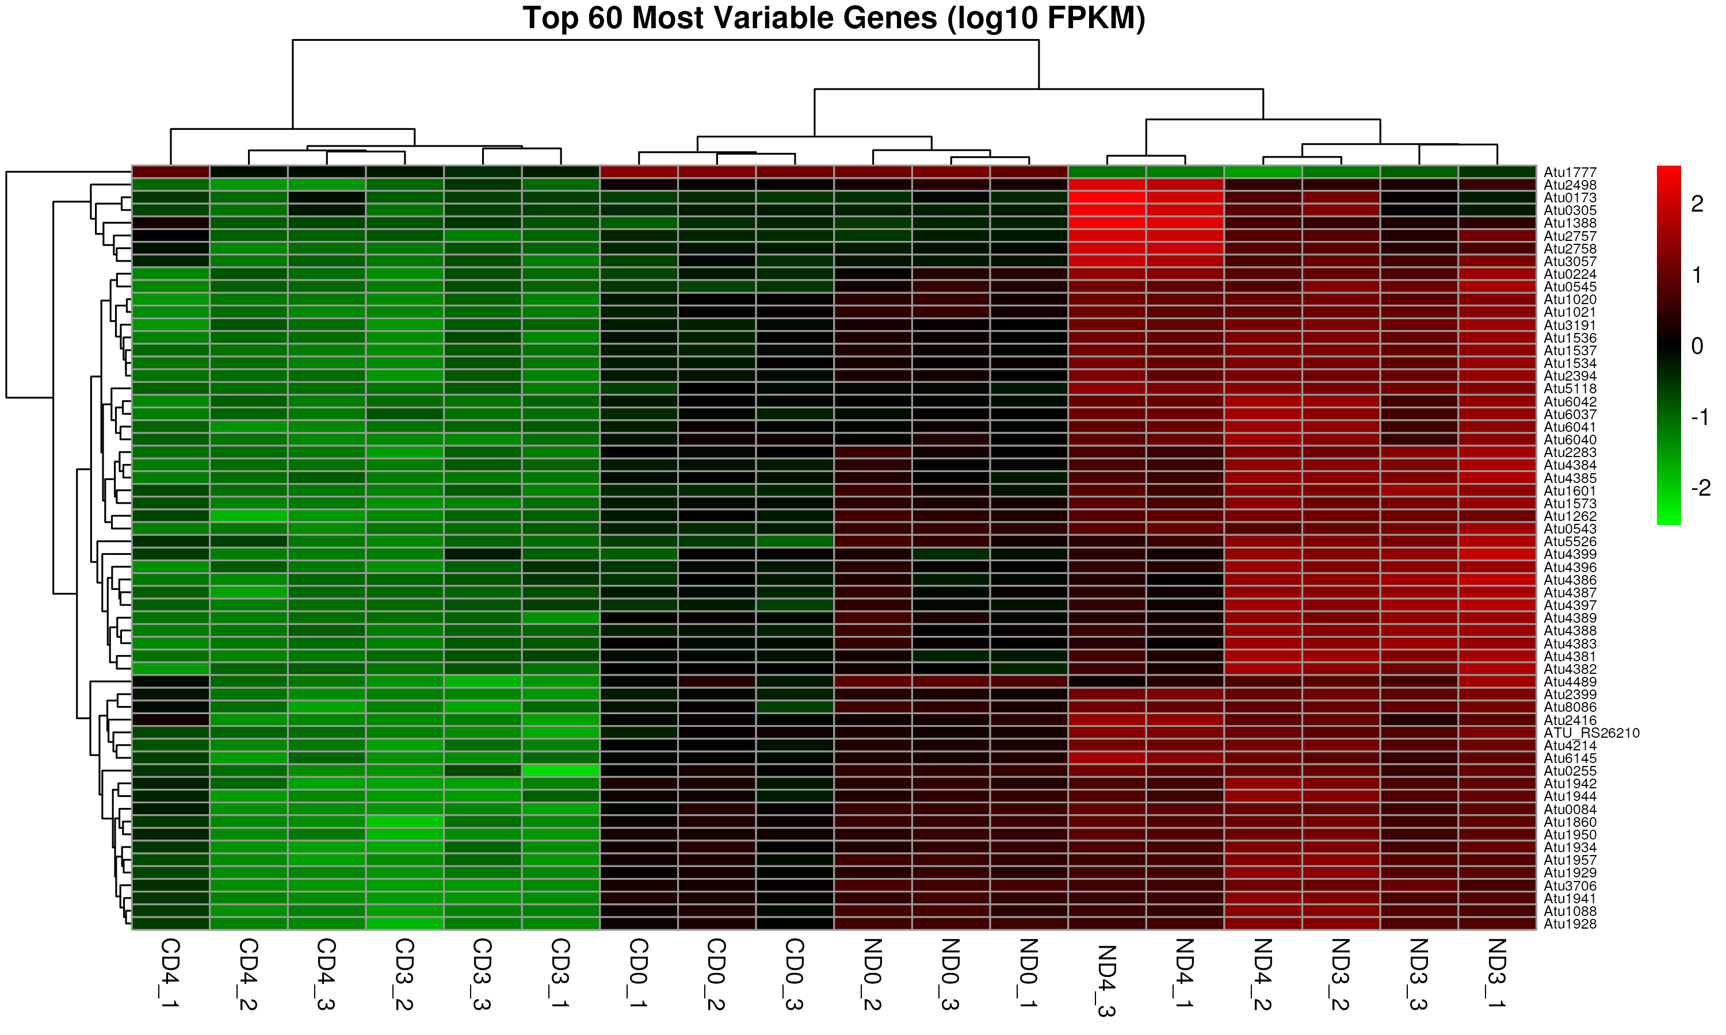
Average Gene Expression Distinct Agrobacterium Transcriptional Responses in recalcitrant tea and transformable tobacco hosts
Additional results

Slide 23
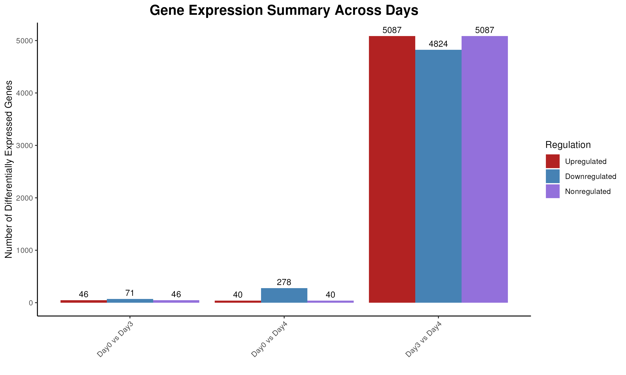

Slide 24
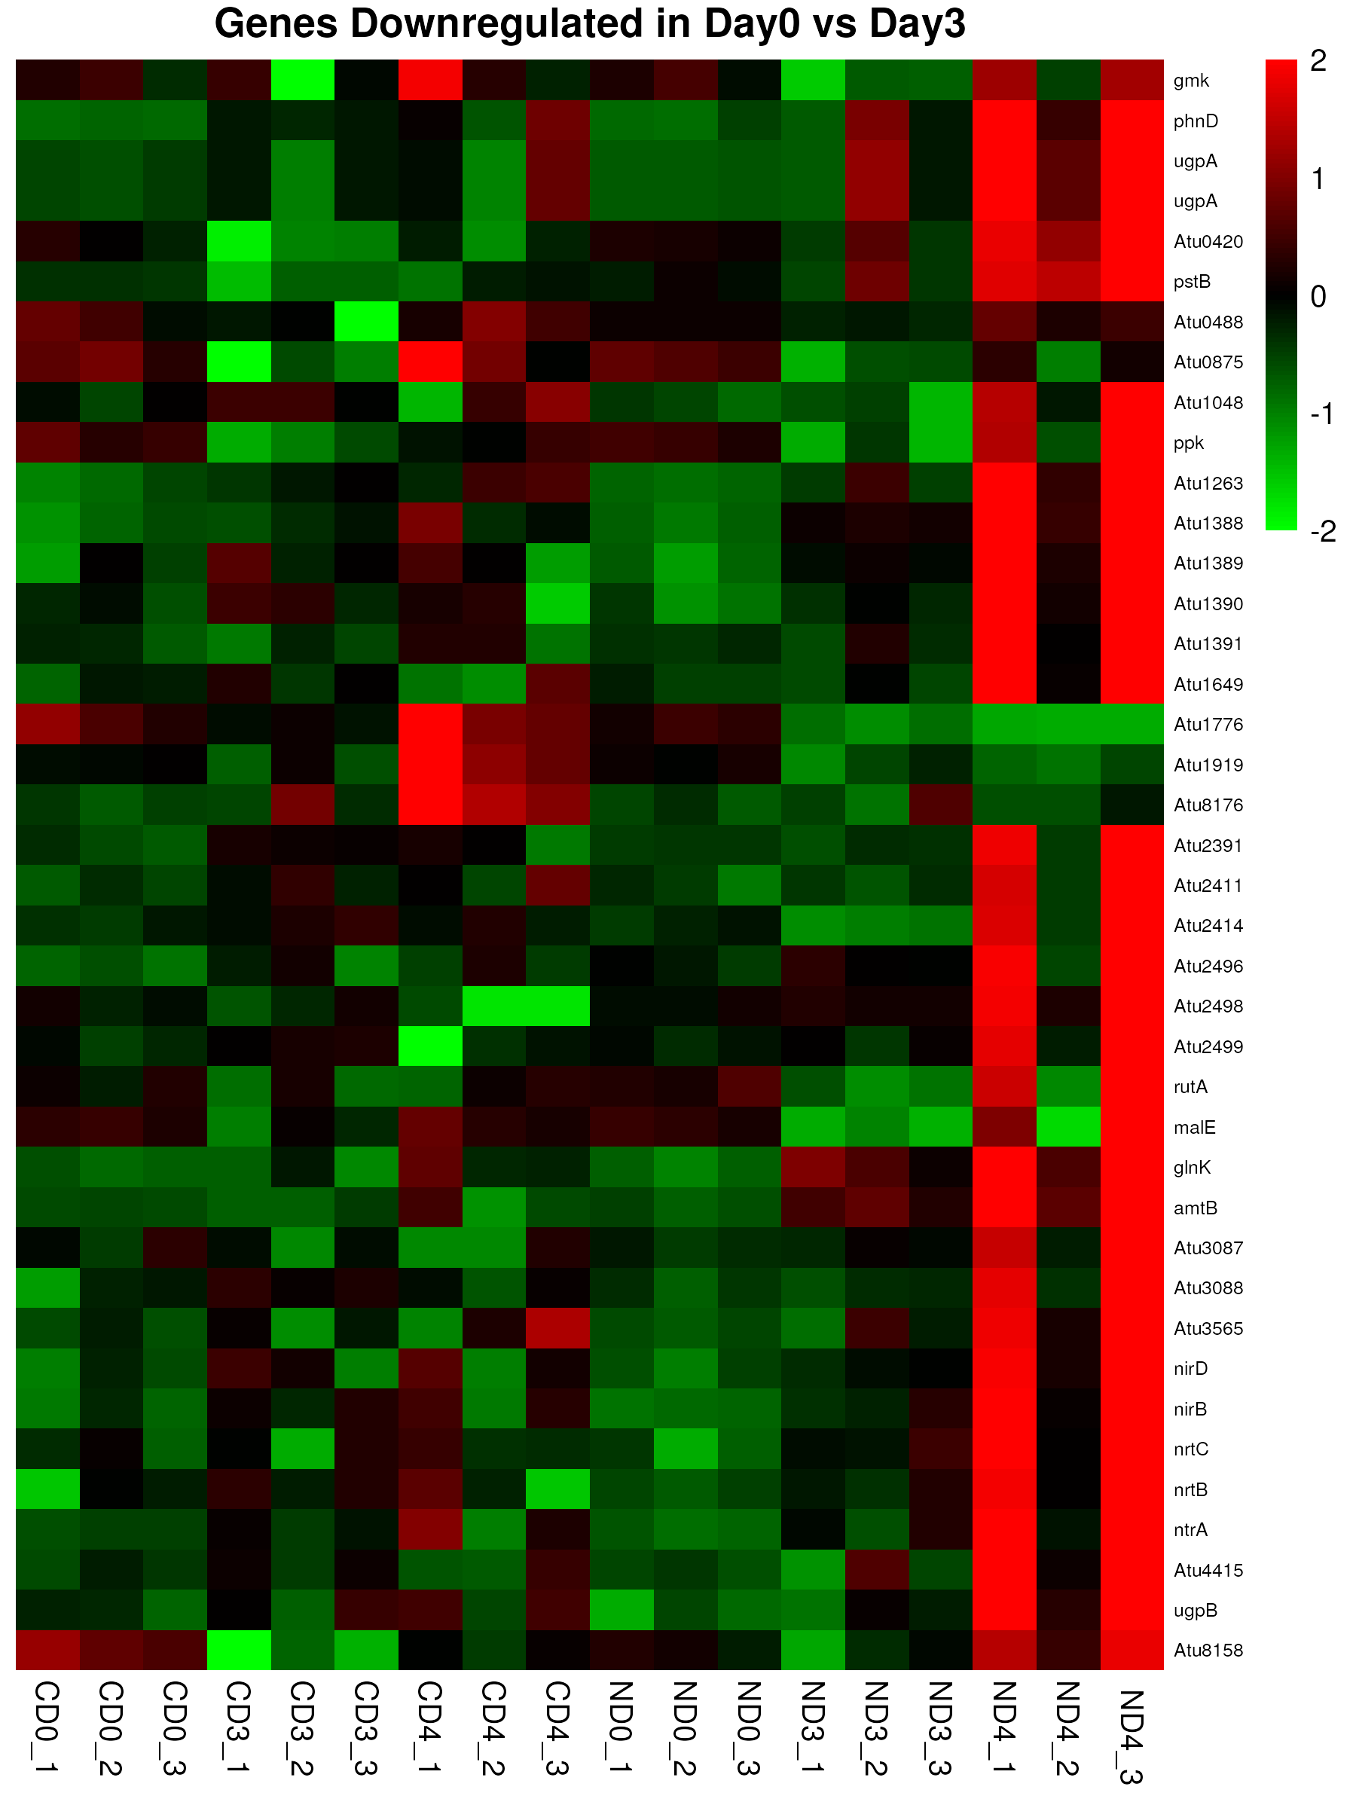
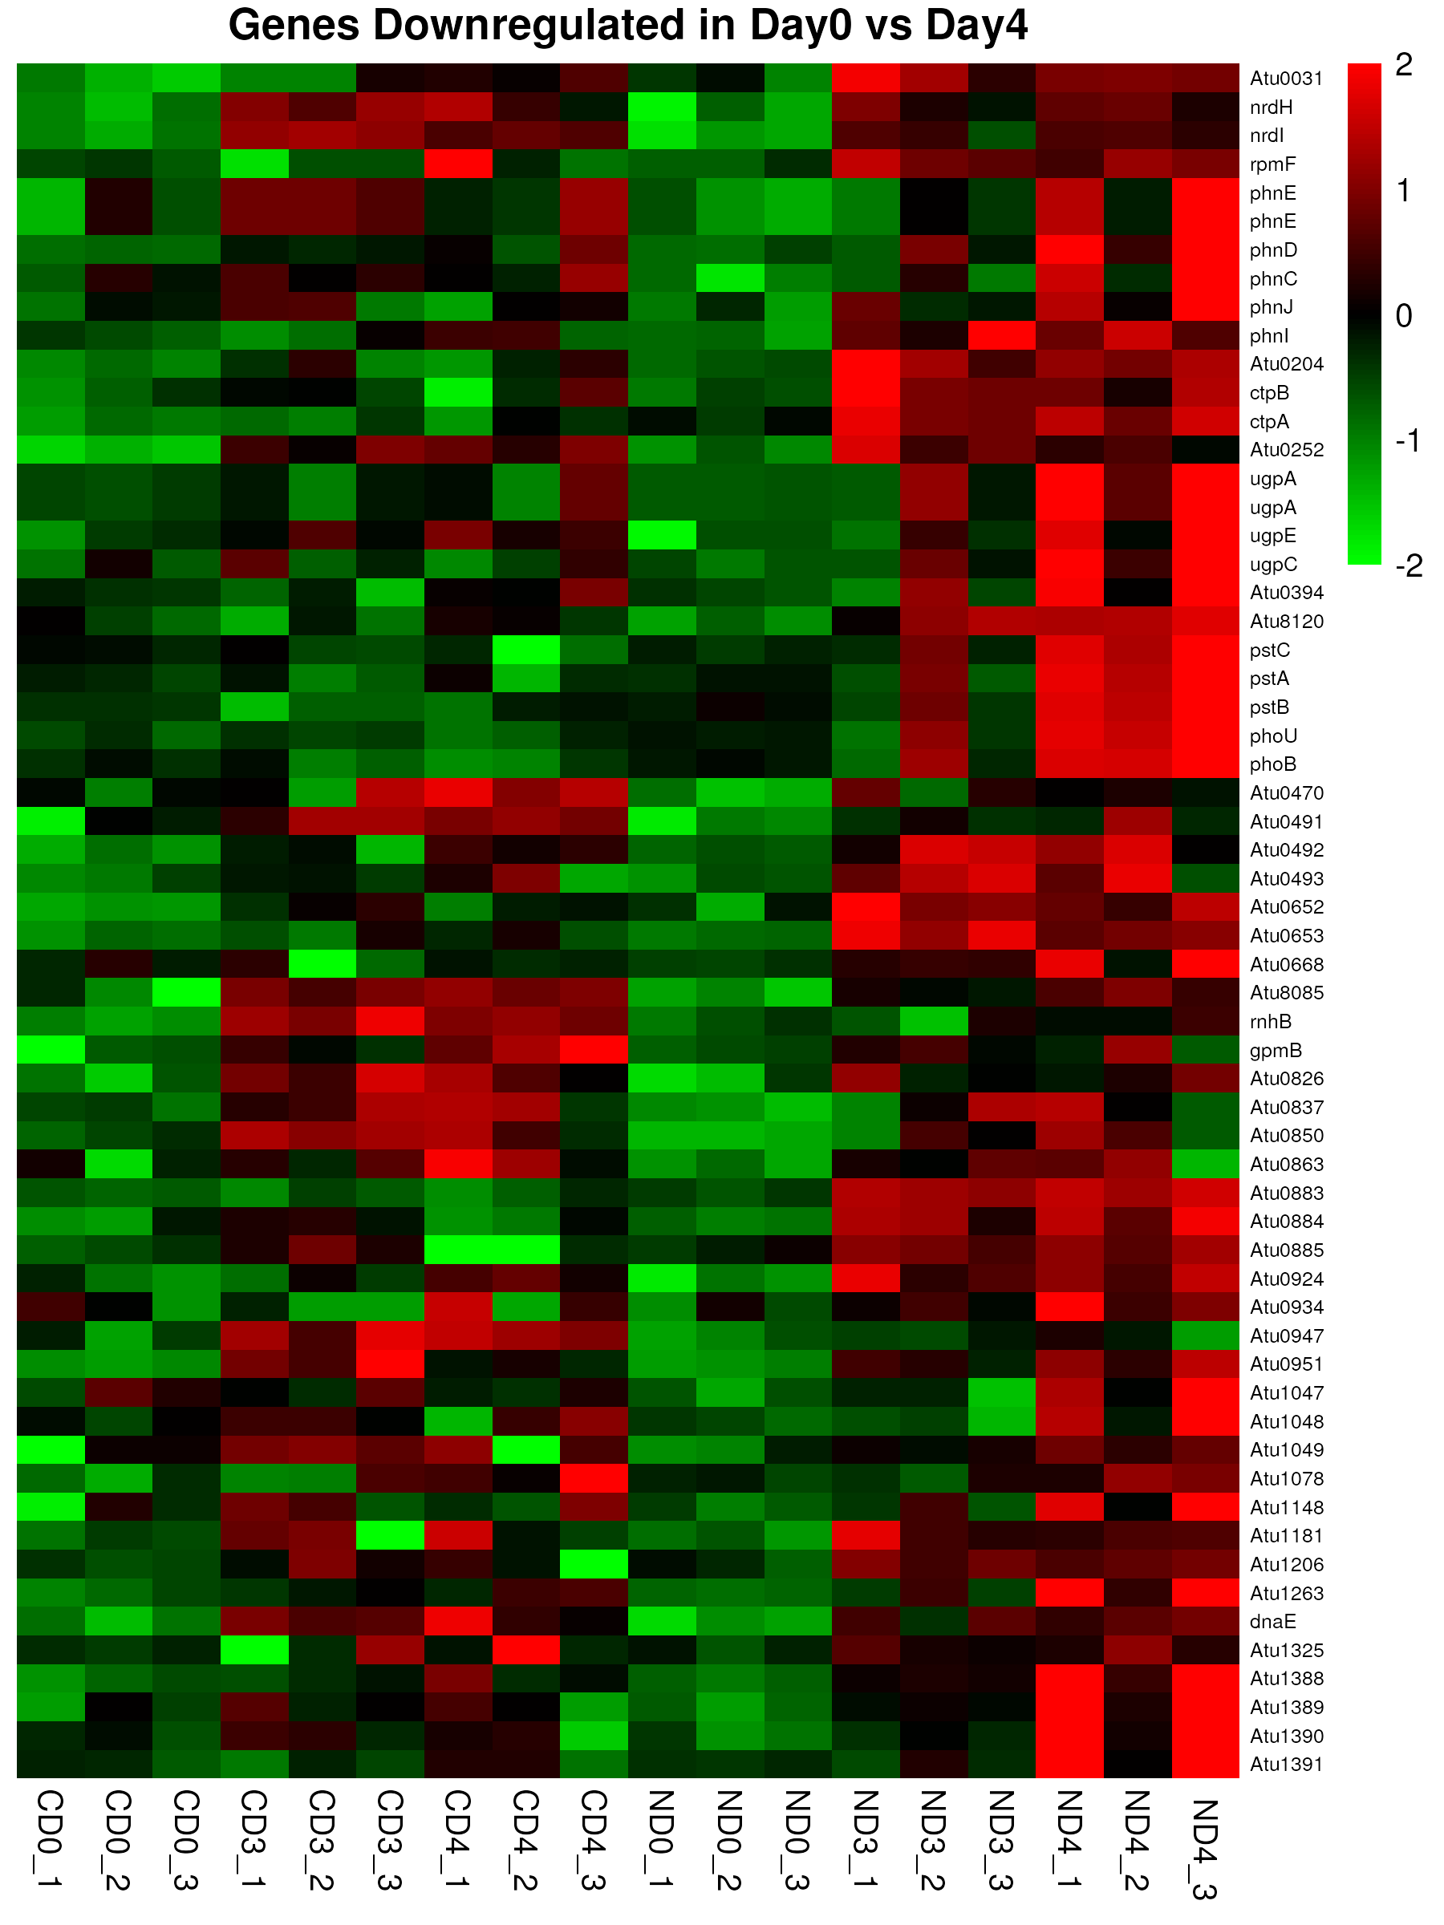

Important genes downregulated across days

Slide 25
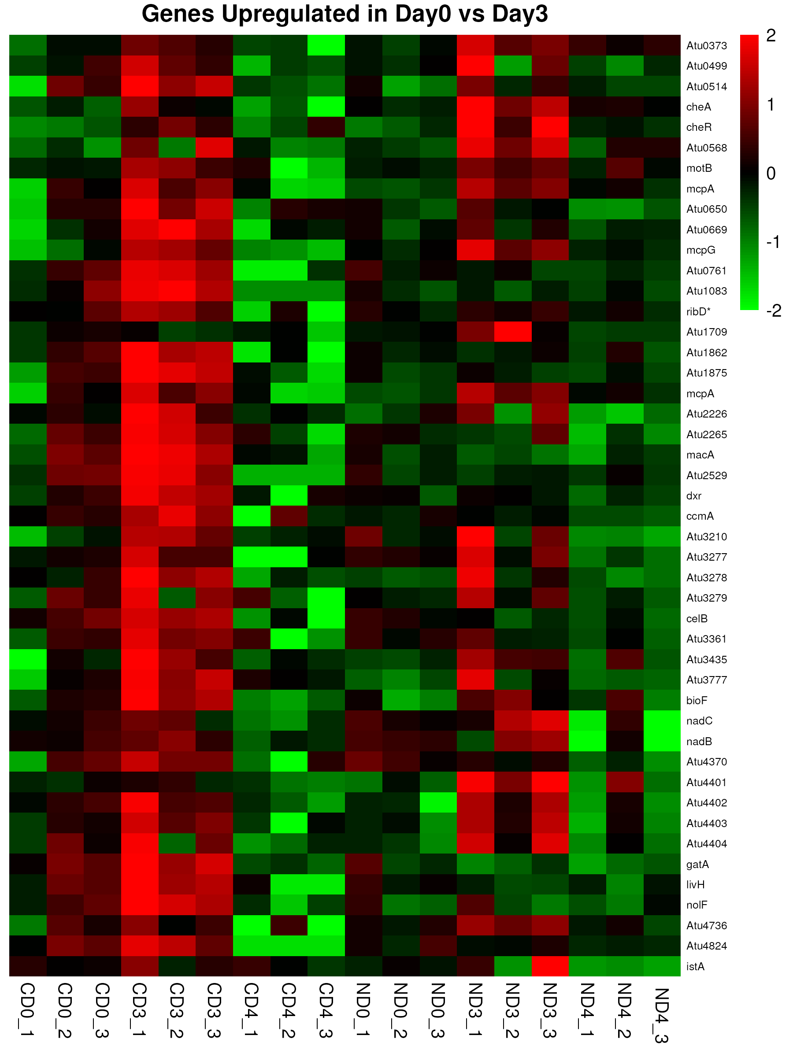
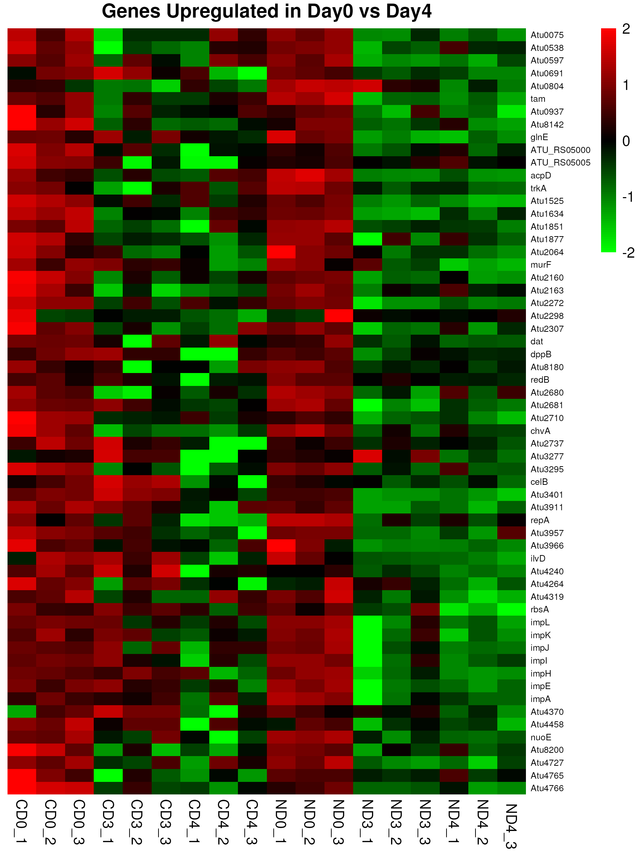

Important genes upregulated across days

Slide 26
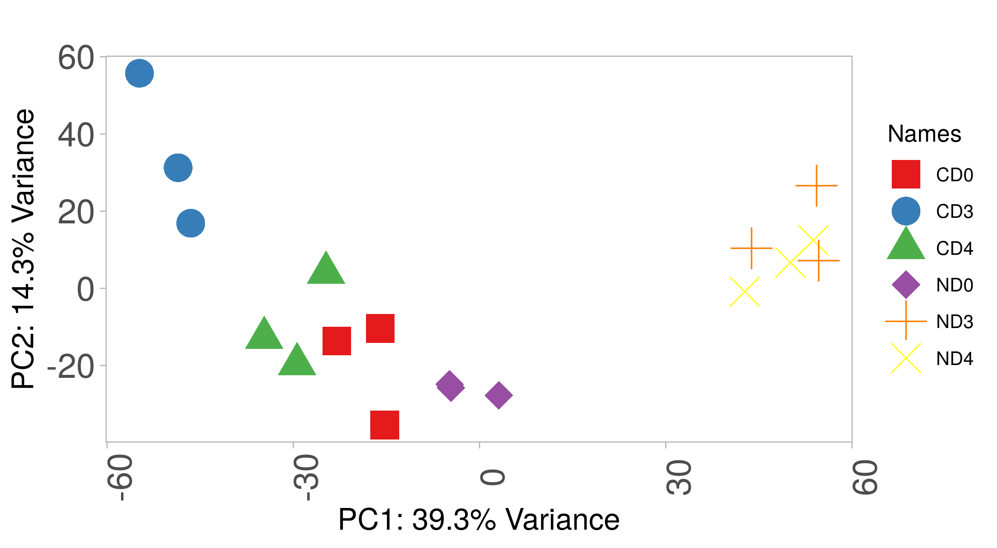
PCA Reveals Distinct Agrobacterium Transcriptional Responses in recalcitrant tea and transformable tobacco hosts
https://usegalaxy.org/

Slide 27
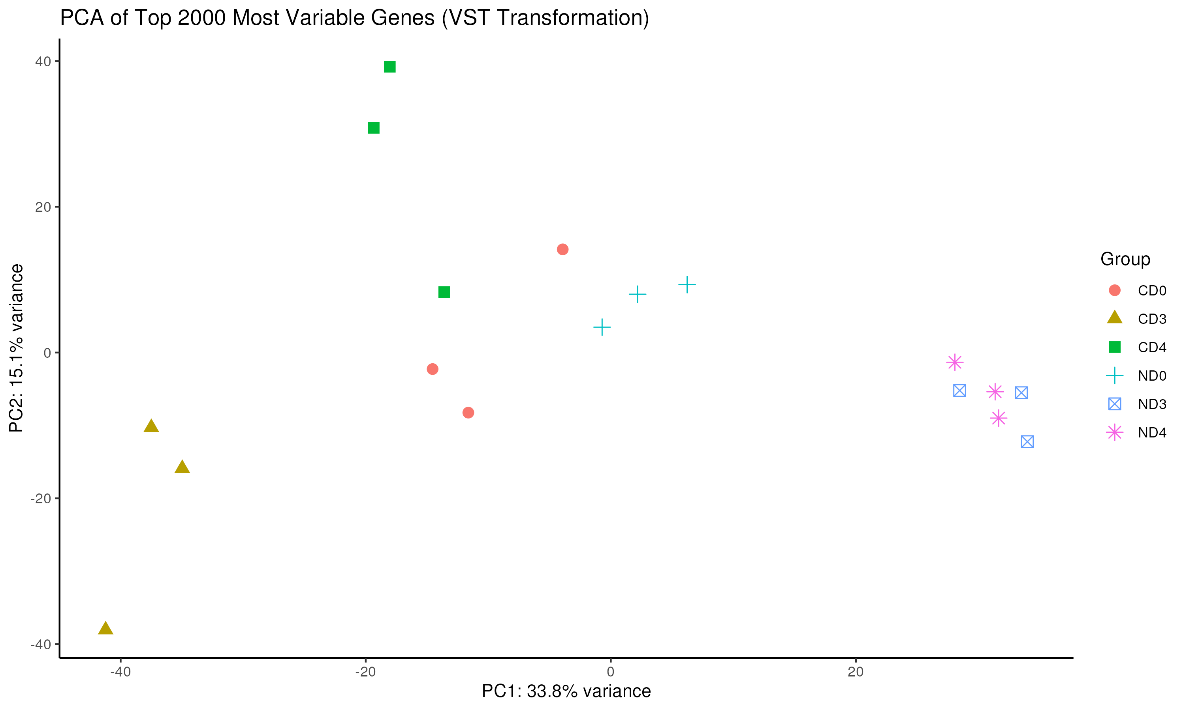
PCA Reveals Distinct Agrobacterium Transcriptional Responses in recalcitrant tea and transformable tobacco hosts

Slide 28
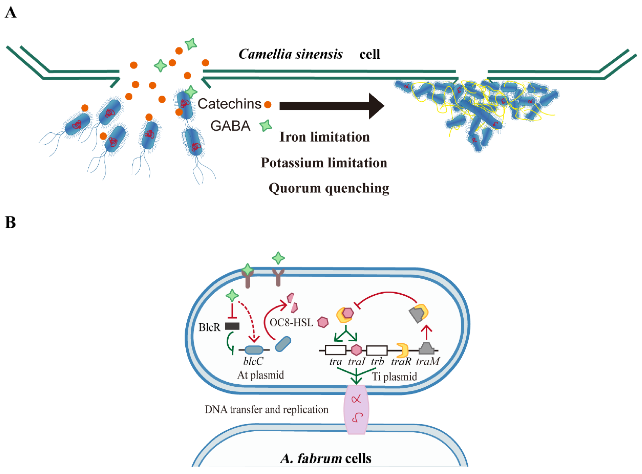
Factors (Genes and Proteins) causing recalcitrance in Tea

Slide 29
Conclusion
Similar DEG patterns were observed on day 3 and day 4, but not on day 0.
Key genes, especially those involved in chemotaxis, quorum sensing, and flagellar assembly, were consistently down-regulated in Agrobacterium exposed to tea.
The original paper could be strengthened by analyzing regulatory changes between time points to better understand dynamic gene expression over the infection timeline
Time course analysis

Slide 30

Any questions are welcome

